Slide 1

Florida preventive care
Jacqlyn Cheng, Anna Dyar, Savannah Jeter, Matthew Lister, Mac Louis, Janice Mathew, Lynn Pellitteri

Slide 2
Preventive Care Engagement Across Florida
Access to healthcare is very low in many areas of Florida with areas experiencing up to 54% of the population without health insurance.
Individuals have low engagement in basic preventive services including annual checkups, cholesterol screening, dental care, and cancer screenings.
Florida is among the top five states for number of uninsured individuals.
14% of Floridians reported avoiding care due to cost. This compares to 9.8% nationally.
In 2022, Florida ranked 40th in the US for preventive care clinical services

Slide 3

Why this is important
According to the CDC, 90% of the nations $4.1 trillion annual health expenditures are for treating preventable chronic conditions such as heart disease, diabetes, and stroke.
This figure does not account for billions in additional costs such as loss of productivity, disability, early retirement, and caregiving burden.
Notes:
** add our data in top five states section. cost is a major barrier to accessing preventive services and primary care in areas with high rates of uninsured

Slide 4
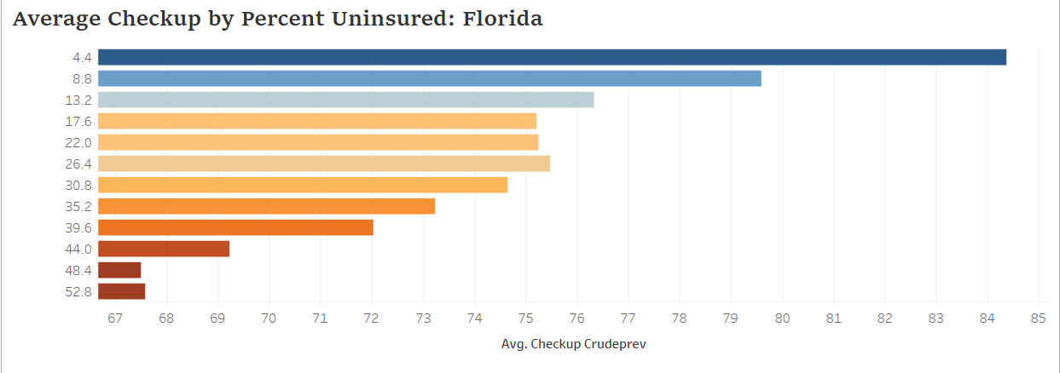
What we can do
Utilize funds from the CDC Preventive Health and Health Services Block Grant (PHHSBG) to sponsor pop-up clinics to provide no-cost preventive services to those in need, potentially lowering cost of chronic disease treatment
Notes:
Presenting to advisory committee that distributes these funds

Slide 5

Why pop-up clinics
Ease of access
Convenient locations
Evening and weekend hours
Pop-ups are shown to provide an entry point to ongoing primary care services by offering positive relationships and referrals to ongoing healthcare services
Low operational cost
Staffed by volunteers from Florida’s Medical Reserve Corps network
Builds ongoing relationships with trusted community partners
Notes:
Services can be accessed in places people already have trusting relationships with to build community engagement-churches, community centers, pharmacies or retail spaces
Accessed outside of normal business hours, weekends
does not require capital, real estate, or permanent staff
Community partnerships contribute to better social health and increased trust in the medical community
Popups have been well documented as a way to connect people with healthcare and have been well-attended in many areas. Seattle, for example, hosted a 4-day clinic seeing over 4k pts. This was also demonstrated through the pandemic with vaccine pop-ups

Slide 6
Cost
Maximum cost for pop-up clinics staffed by volunteers is $65 per patient
This includes administrative fees, marketing materials, labs, and supplies
Significantly lower than clinic visits ($200-500 per patient) or Emergency Department visits ($900+ per patient)
$2.5m allows for at least two pop-ups per year in each of the five most underserved locations

Slide 7
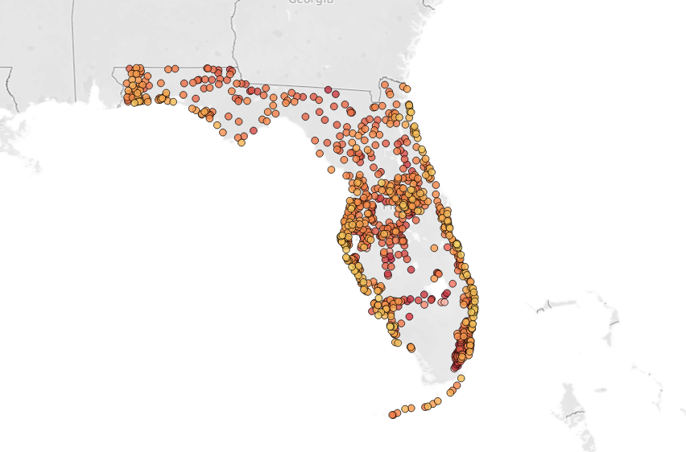
Recommended target areas
Target top five locations by percent uninsured and total population
Immolokee
Fellsmere
Indiantown
Southeast Arcadia
Montura

Slide 8
References and Resources
Dataset: https://chronicdata.cdc.gov/500-Cities-Places/PLACES-Place-Data-GIS-Friendly-Format-2022-release/vgc8-iyc4
Dashboard: [link here]
Also cited:
Centers for Disease Control and Prevention. (2023, March 23). Health and economic costs of chronic diseases. Centers for Disease Control and Prevention. Retrieved April 15, 2023, from https://www.cdc.gov/chronicdisease/about/costs/index.htm
Pop-Up Clinics: A Starting Point for Good Primary Care. (2019, August 12). Eden Health. https://www.edenhealth.com/blog/pop-up-clinics/
America’s Health Rankings | AHR. (n.d.). America’s Health Rankings. Retrieved April 15, 2023, from https://www.americashealthrankings.org/explore/annual/measure/preventive_clinical/state/FL
Attipoe-Dorcoo, S., Delgado, R., Lai, D., Gupta, A., & Linder, S. (2020). Analysis of annual costs of mobile clinics in the Southern United States. Journal of primary care & community health. Retrieved April 22, 2023, from https://www.ncbi.nlm.nih.gov/pmc/articles/PMC7758644/

